Slide 1
Modelling EU Climate Policy
Cambridge Econometrics training course
Hector Pollitt, Cambridge Econometrics
September 2015

Slide 2
Disclaimer
This presentation does not necessarily represent the views of the European Commission (EC) or any collaborating institution

Slide 3
Overview
Institutional framework
Environmental taxes and ETR
Emissions targets
The EU ETS
Energy efficiency
Green jobs
Other research
Overall conclusions

Slide 4
Institutional Framework
In Europe, policy is determined at Member State level, unless there are grounds to set policy at European level (subsidiarity principle)
If there is a need for policy at European level, it will be proposed and assessed by the European Commission
It is then put before the European Council and the European Parliament

Slide 5
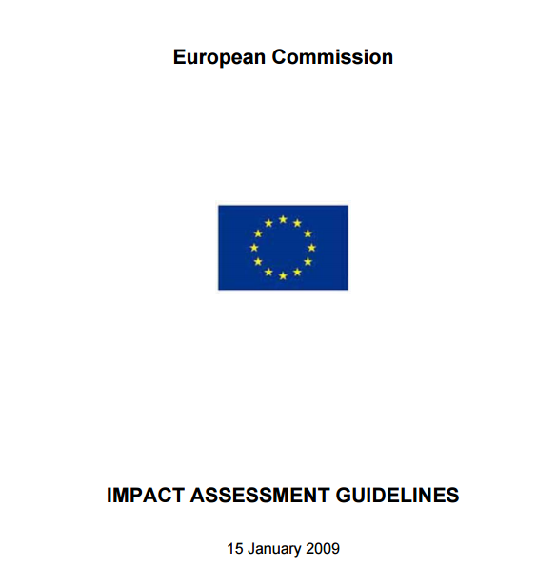
Institutional Framework (cont.)
This presentation describes how modelling contributes to the assessment
The overall assessment must follow the Impact Assessment Guidelines

Slide 6
Energy Taxes and ETR
E3ME was used in the COMETR and petrE research projects
These were ex-post and ex-ante assessments of Environmental Tax Reform
ETR was a relatively new concept when the COMETR project started…
Notes:
Describe ETR as opposed to energy taxes
1990s 6 EU countries implemented ETR in COMETR

Slide 7
How Energy Taxes are Modelled
Increase in energy prices
Reduction in energy consumption
Reduction in emissions
Households
Industry
Loss of real income
Loss of competitiveness
Loss of jobs
Worsening trade balance
Lower spending
Loss of output

Slide 8
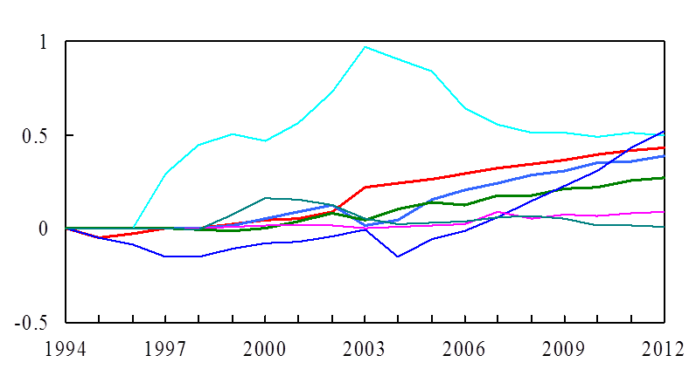
Impacts of ETR on GDP in the 1990s
% difference
Finland
Netherlands
Germany
Denmark
Slovenia
Sweden
UK
Note(s) :% difference is the difference between the base case and the counter factual
reference case.
Source(s) : CE.
Taken from COMETR final report and publications

Slide 9
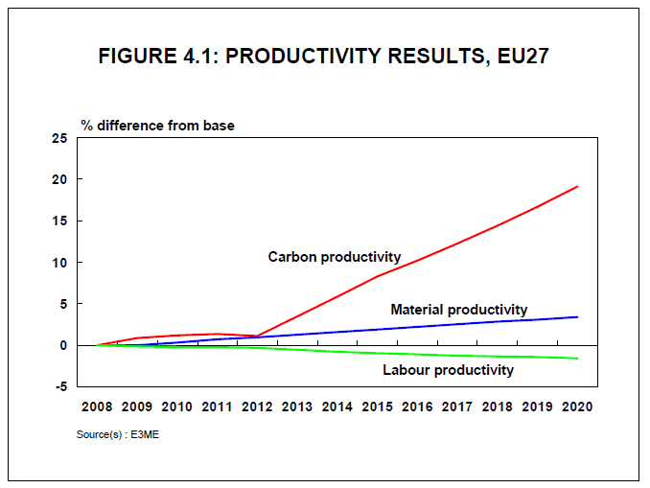
Future Impacts of ETR
Taken from petrE final working paper

Slide 10
Distributional Impacts of ETR
Source(s): EEA.

Slide 11
The Energy Taxation Directive
CE worked with the EC (DG TAXUD) to assess potential options for revising the Energy Taxation Directive
E3ME was used to model the impacts on the economy, energy consumption and emissions
Notes:
Describe ETR as opposed to energy taxes
1990s 6 EU countries implemented ETR in COMETR

Slide 12
Emissions Targets
E3ME and a CGE model were used to assess the impacts on GDP and employment of:
  extending the EU’s 20% GHG reduction target to 30%
  setting different targets for 2030
E3ME was linked to a detailed energy systems model (PRIMES) to provide the assessment

Slide 13
Why Use Two Economic Models?
The two models are founded in different schools of economics:
  E3ME is an econometric model that uses an empirical approach
  GEM-E3 is a CGE model that is based on standard economic theory
But both models have “E3” coverage of economy, energy and emissions, and both have 2-digit level sectoral detail. See:
  www.e3me.com
  www.gem-e3.net/

Slide 14
Summary Impacts, EU GDP (2020)
Domestic
CDMs
GEM-E3
E3MG

Slide 15
The EU ETS
CE has worked with DG CLIMA (previously part of DG Environment) at EU level
The E3ME model was used to assess the economic impacts of different mechanisms for allocating ETS allowances – the ETS also features in many other assessments
Notes:
Mention that ETS is modelled same way as energy taxes, just with a target quantity rather than price. ETS price scales to match quantity.

Slide 16
The EU ETS - Results
Model results are dependent on assumptions about opportunity cost pricing
It is also important to note that (unlike CGE models) E3ME does not assume 100% cost pass-through
Model results show benefits to GDP of auctioning allowances, usually at the expense of industry profits

Slide 17
Energy Efficiency
E3ME used to provide input to the assessment of the Energy Efficiency Directive
It also contributed to the assessment of the targets that were set for 2030
Notes:
Mention E-E as a policy – other projects (RAP and CF)

Slide 18
Energy Efficiency – Economic Impacts
Investment
Funds to pay for investment
+ve
-ve
GDP and jobs
+ve
Reduction in Energy Imports
Notes:
Mention how ratio of investment to energy consumption estimated

Slide 19
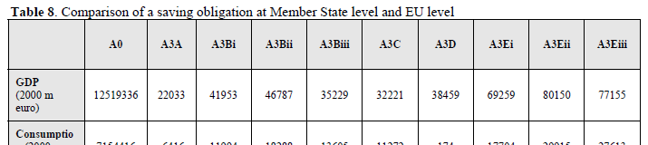
The Scenario Results
GDP impacts were found to be small and positive in the scenarios in which Energy Savings Obligations were imposed (figures for 2020)
Source: Energy Efficiency Directive Impact Assessment (annexes, p33)
Scenarios with ESO to meet 20% targets
GDP increases by 0.3%
Higher ambition scenarios
GDP increases by 0.6%
Baseline

Slide 20
Energy Efficiency – Summary Results
Implementing efficiency measures provides a net boost to GDP and employment
  mainly due to reduced fuel imports
  there is also a welfare gain from not having to heat households
There are important sectoral impacts
  main losers are energy sectors
  main winners are investment sectors
  this has important jobs/skills implications

Slide 21
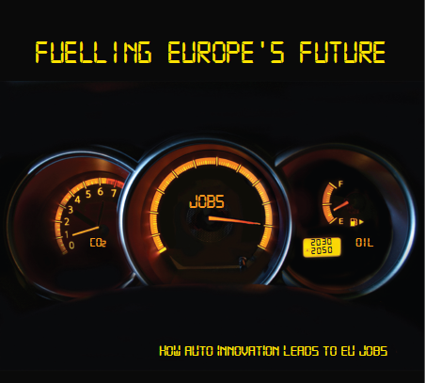
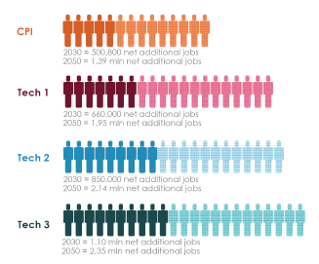
Energy Efficiency – Transport
Figure shows additional jobs created in the EU by improving efficiency in light-duty vehicles, compared to maintaining current rates of efficiency
http://www.camecon.com/Libraries/Downloadable_Files/Fuelling_Europe_s_Future-_How_auto_innovation_leads_to_EU_jobs.sflb.ashx

Slide 22
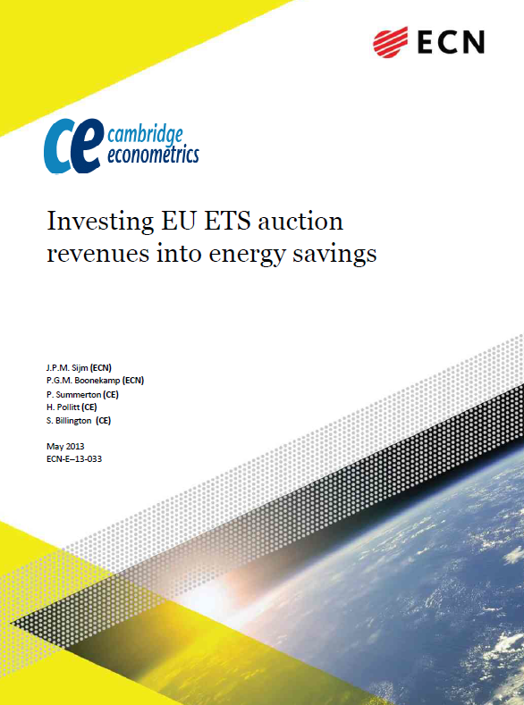
Interaction with the EU ETS
Study for the Regulatory Assistance Project
Team involved ECN (Netherlands) and Cambridge Econometrics
Assessed the interaction between the EU ETS and energy efficiency programmes in Europe
Available online:
http://www.ecn.nl/docs/library/report/2013/e13033.pdf

Slide 23
Summary Conclusions
Both models include a wide range of sectors, linked by input-output tables; possible impacts:
  clearly on energy sectors
  sectors that produce investment goods could benefit
  energy-intensive sectors will face a loss of competitiveness impacts, but some may see increased demand for their products
  if any revenues are used to offset taxes elsewhere, services sectors could benefit
But, the models can only go so far – more detailed analysis is required for key sectors

Slide 24
Green Jobs
Assessment for EC, DG Employment
An important political issue, but often not well understood
E3ME was used to provide an assessment of employment impacts from meeting the 20-20-20 targets

Slide 25
Results for Employment
S6 shows energy efficiency targets met
Other scenarios show climate targets met
Baseline = 0.0

Slide 26
Results for Occupations
Source: ‘Green Jobs’ report, Cambridge Econometrics et al (2011)

Slide 27
Green Jobs - Results
The modelling results suggest that the EU targets will lead to slightly higher employment rates
  mainly due to a shift from energy to labour/capital inputs
  sectors that benefit the most are construction/engineering
The study then assessed the skills impacts of this, but this is at too detailed a level to use a macroeconomic model

Slide 28
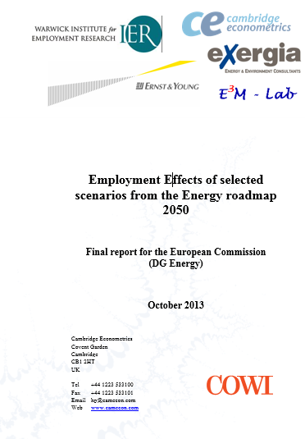
The EU Energy Roadmap 2050
Expanded on the previous work for DG Employment
Team included Cambridge Econometrics, E3M-Lab (NTUA), Ernst & Young, Exergia, GHK and IER (Warwick)
Considered longer-term (2050) impacts and used both macro-econometric and CGE modelling approaches
DG ENER published results in early 2014:
http://www.cedefop.europa.eu/EN/Files/5534_en.pdf

Slide 29
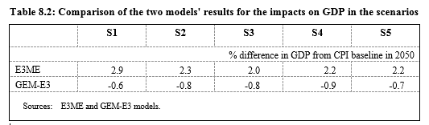
GDP Impacts
The scenarios show different ways of meeting the EU’s 2050 decarbonisation targets
Two models were run – the macro-econometric E3ME model and the CGE GEM-E3 model
Employment results are shown on the next slide; first GDP impacts
  S1 – High energy efficiency
  S2 –Diversified energy supply
  S3 – High renewables
  S4 – Delayed CCS
  S5 – Low nuclear
Source: Employment Effects of the Energy Roadmap, Cambridge Econometrics et al (2013)

Slide 30
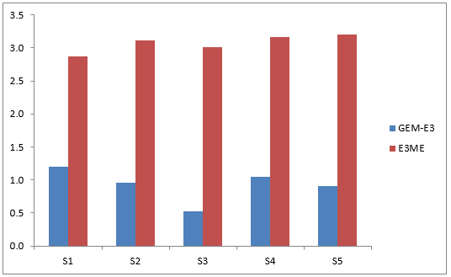
And (again) employment results
High energy efficiency
High RES
Delayed CCS and low nuclear cases
Diversified
Source: Employment Effects of the Energy Roadmap, Cambridge Econometrics et al (2013)
Figure shows % change in employment from baseline, 2050

Slide 31
Other Related Research
E3ME has also been used for:
  assessing the impacts of introducing an EU SO2/NOx trading scheme
  modelling demand for minerals and biomass materials
  other non-environmental (particularly labour market) applications
  assessment of first-mover advantage
  assessment of REDD policy
  benefits of international cooperation on climate policy
  analysis of trade policy

